Slide 1

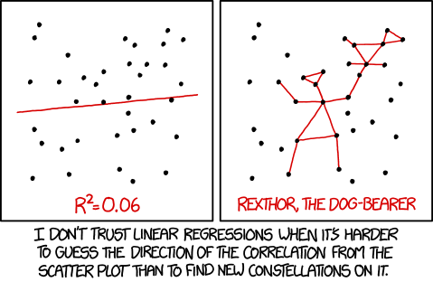
Linear classifiers
Gosztolya Gábor
University of Szeged
Institute of Informatics
2023 / Apr / 06

Slide 2
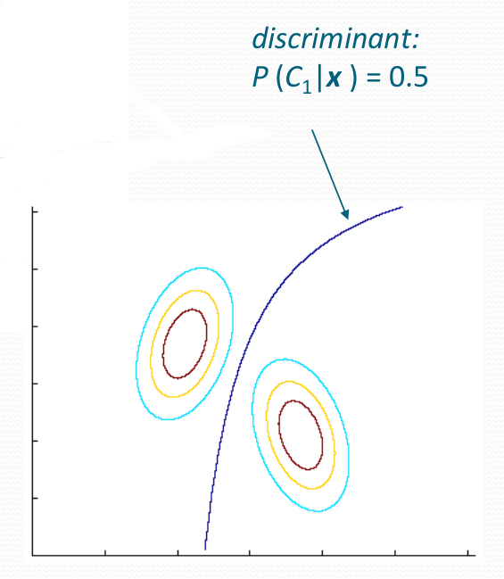
Introduction
Remember that Bayes’ decision rule requires the knowledge of either
P(c_{i}|X), or P(X|c_{i}) and P(c_{i})
We showed how to create an estimate for P(X|c_{i}) using one Gaussian curve or a mixture of Gaussians
We also showed that modeling the distributions implicitly models the discriminant functions as well

Slide 3
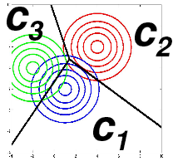
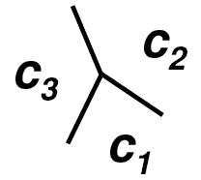
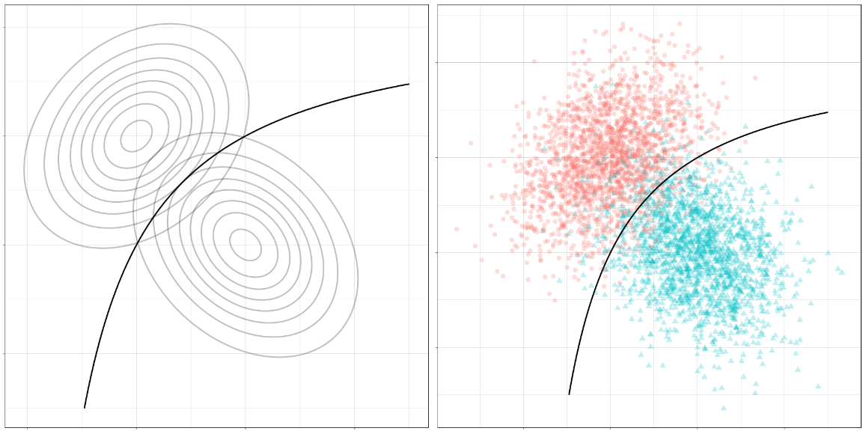
Introduction #2
However, in practice there will always be a mismatch between the assumed and the real distribution
Also, for the classification we don’t need the distributions,
just the discriminant functions
This gives the idea to model the discriminant functions
directly
  Seems to be an easier problem than estimating the distribution…

Slide 4
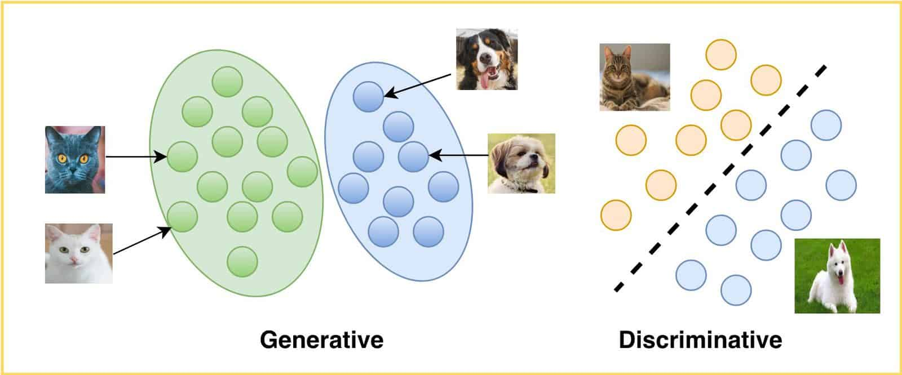
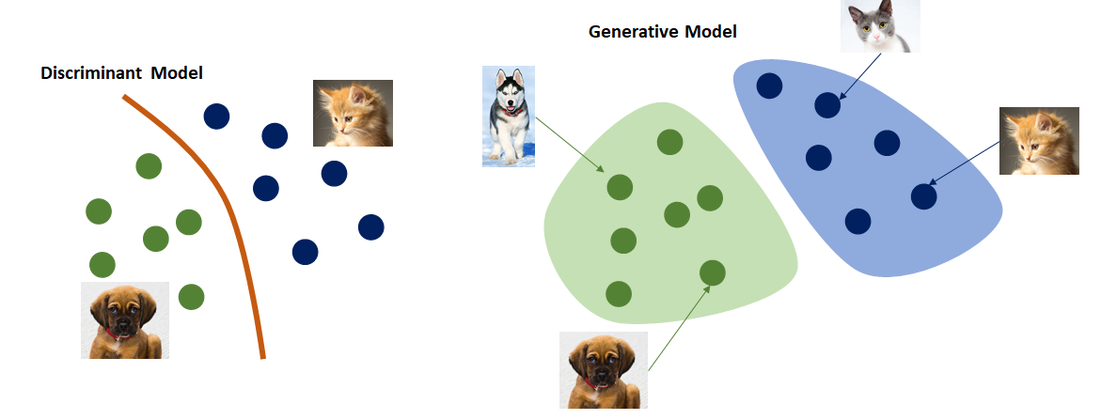
Some naming conventions
Generative methods
  …since they can be used to generate samples
  Model the examples belonging to the given class
  More related to the estimation of P(X|c_{i})
Discriminative methods
  …since they focus on discriminating the classes
  They model the geometry of the decision surface
  More related to the estimation of P(c_{i}|X)
The two views are not completely distinct
  For example, there are discriminative training methods for Gaussian Mixture Models

Slide 5
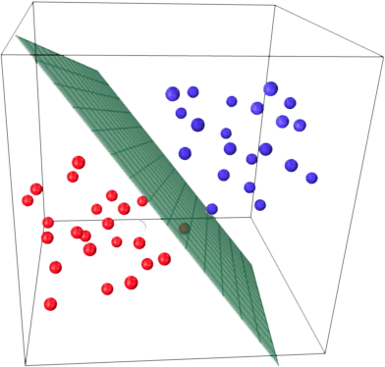
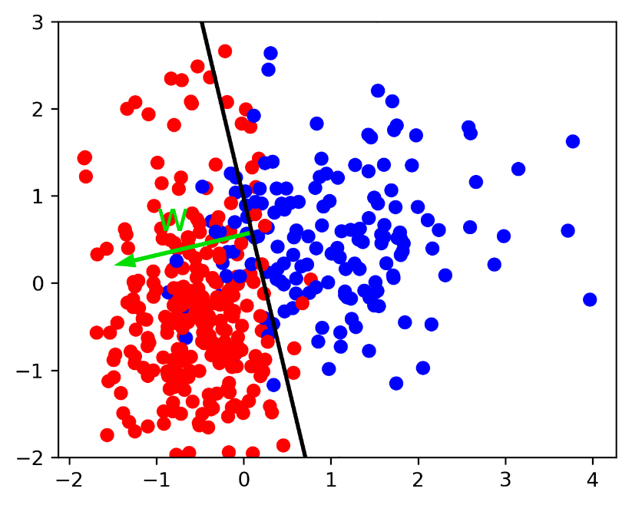
Linear classifiers
Now we focus on methods that directly model the discriminant functions
As the simplest case, we will study the case of linear discriminant functions
  We know that they are optimal in the case of Gaussian class distributions with equal covariances
  They may not be optimal for other distributions, but they are very easy to use

Slide 6
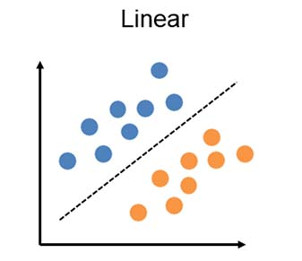
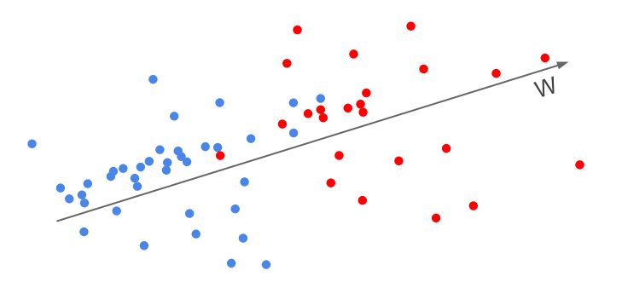
Linear classifiers #2
They perform poorly for most practical problems
  But they will form the basis of two of the best machine learning approaches: neural networks and support vector machines
First, we discuss the case of having only two classes
  …since that leads to a simpler model
  Later we will see how to extend the methods to more classes

Slide 7
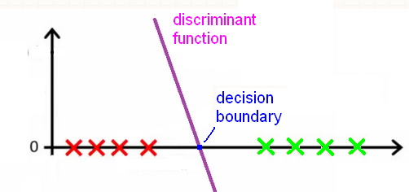
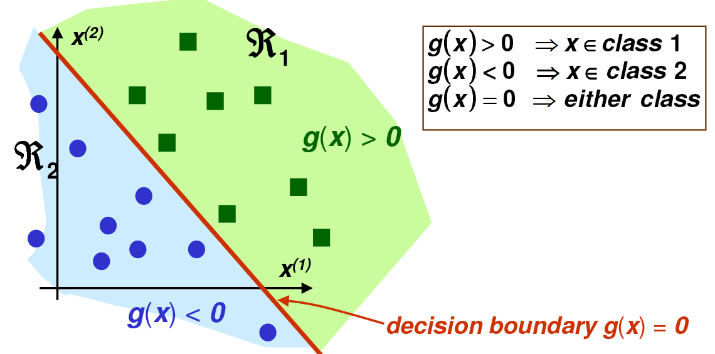
Linear discriminant functions
A discriminant function is called linear if it has the form:
g(x) = w^{t}x + w₀
  …where w is the weight vector and w₀ is the “bias” or “threshold”
The linear discriminant function is a line in 1D, a plane in 2D,…
The decision boundary is where
  It is a point in 1D, a line in 2D, a plane in 3D, … (→ hyperplane)

Slide 8
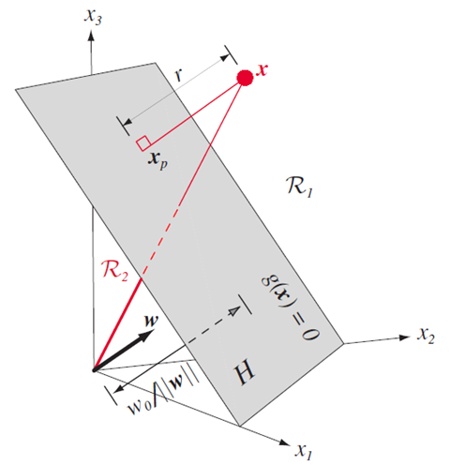
Some coordinate geometry…
w determines the orientation of the decision surface (hyperplane)
  w is the normal vector of the plane
w₀ determines the location of the decision hyperplane
Notice that multiplying g(x) by a constant changes the steepness of the discriminant function, but won’t change the dec. surface!
  So the distance of a point x from the decision surface is given by

Slide 9
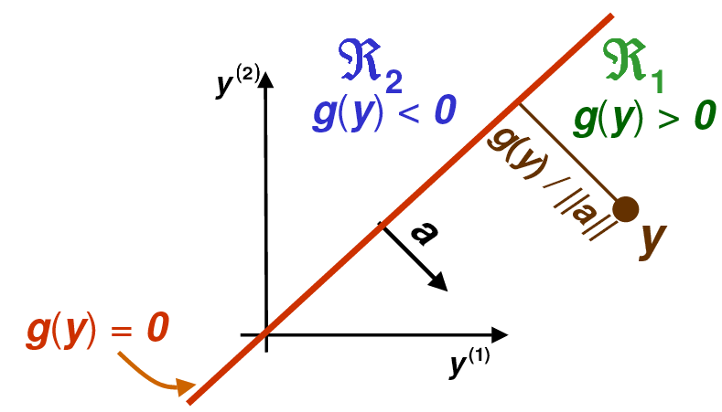
Simplifying the notation
We simplify the notation by fusing w₀ into w
  Instead of (w₁, w₂, … w_{d}) we use the weight vector a=(w₀, w₁, w₂, …w_{d})
  And we also augment the feature vector as: y=(1, x₁, x₂,…,x_{d})
With this, instead of g(x) = w^{t}x + w₀ we can write: g(y) = a^{t}y
So we have a homogeneous
discriminant function
  Meaning that the decision boundary
  goes through the origin
  …in the larger feature space (as we have
  one more dimension)

Slide 10
Training the linear classifier
We start with the two-class case
Given samples from classes c₁ and c2, how can we select the weight so that the classification error is zero?
Remember that: g(y_{i}) > 0 → y_{i} classified as c₁
g(y_{i}) < 0 → y_{i} classified as c₂
So the classification error is zero if:
g(y_{i}) > 0 ∀y_{i} ∈ c₁
g(y_{i}) < 0 ∀y_{i} ∈ c₂

Slide 11
Training the linear classifier #2
So the classification error is zero if:
g(y_{i}) > 0 ∀y_{i} ∈ c₁ and g(y_{i}) < 0 ∀y_{i} ∈ c₂
Equivalently, the error is zero if:
a^{t}y_{i} > 0 ∀y_{i} ∈ c₁ and a^{t}(-y_{i}) < 0 ∀y_{i} ∈ c₂
Normalization step: we multiply all samples from c₂ by -1:
y_{i} → -y_{i} ∀y_{i} ∈ c₂
Now we can formalize the goal of training as finding a weight vector a for which a^{t}y_{i} > 0 ∀y_{i}

Slide 12
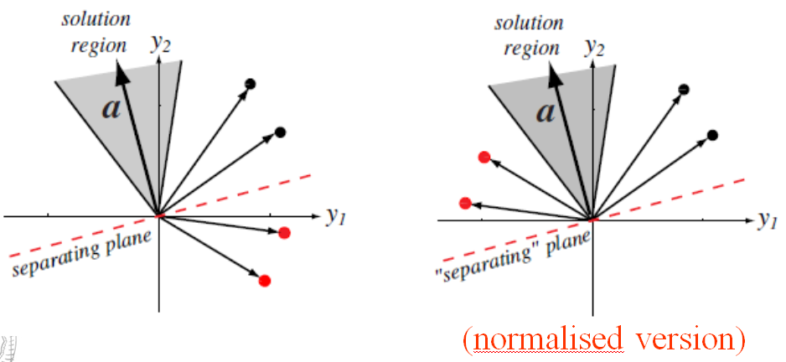
Visualizing the classification problem
All vectors from the shaded region give a good solution
  So usually there is no unique solution, rather a solution region
We seek a hyperplane that separates the samples
We seek a hyperplane that puts the normalized samples on the same side

Slide 13
Training the linear classifier
The goal of training is to find a weight vector a for which
a^{t}y_{i} > 0 ∀y_{i}
There exist several methods for this
  The perceptron algorithm gives an iterative solution
  The linear regression method defines an error function and solves this by a closed-form solution
  The gradient descent method optimizes the same error function by an iterative solution
  The Ho-Kayshap procedure uses a modified error function
  Generalizing the linear discriminant function leads to logistic regression

Slide 14

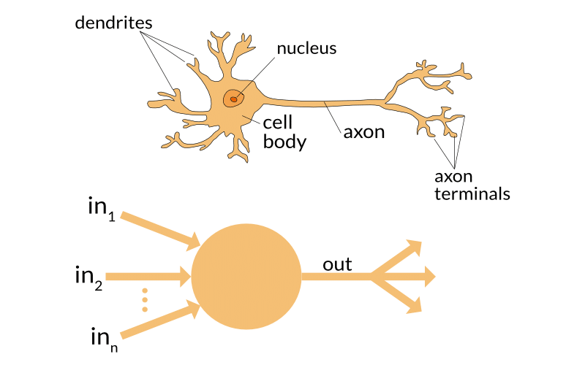
Perceptron
Rosenblatt invented the linear classifier as the “perceptron” in 1957
He also proposed a training method
  → perceptron learning rule
He pointed out the similarity of the model to biological neurons
This was the origin of the “artificial neural network” research field
  Artificial Neural Networks (ANN) = Multi-Layer Perceptron (MLP)
  Of course we do not even have a single layer

Slide 15
The perceptron learning rule
Iterative algorithm
  So it goes through the training samples many times
Realization:
  1) If a sample is correctly classified, it does nothing
  2) If a sample is misclassified, it modifies the weights
If the two classes are linearly separable, then it finds a good solution in finite steps
However, it guarantees nothing when there is no solution
  This is why we will prefer other methods later

Slide 16
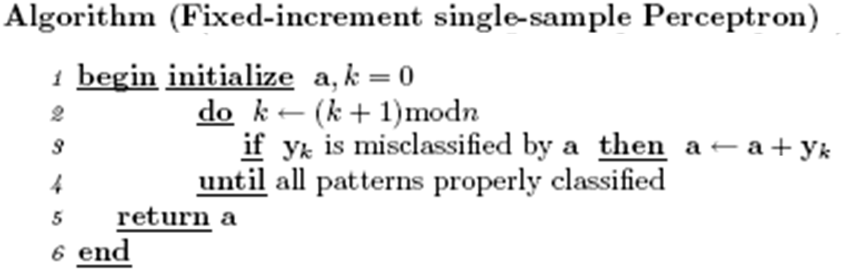
The perceptron learning rule #2
Proof that it modifies the weights in the right direction:
  A sample is misclassified if (a^{(k)})^{t}y_{k} ≤ 0
  In that case, the algorithm updates the weights: a^{(k+1)} = a^{(k)} + y_{k}
  Then the output value changes as: ≥ 0
  (a^{(k+1)})^{t}y_{k} = (a^{(k)} + y_{k})^{t}y_{k} = (a^{(k)})^{t}y_{k} + y_{k}² ≥ (a^{(k)})^{t}y_{k}

Slide 17
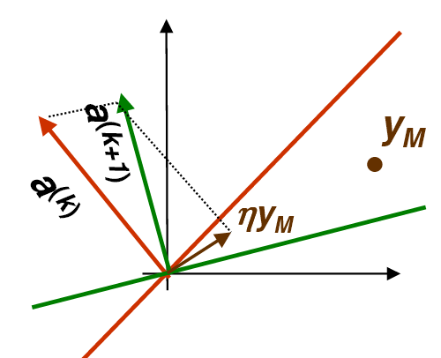
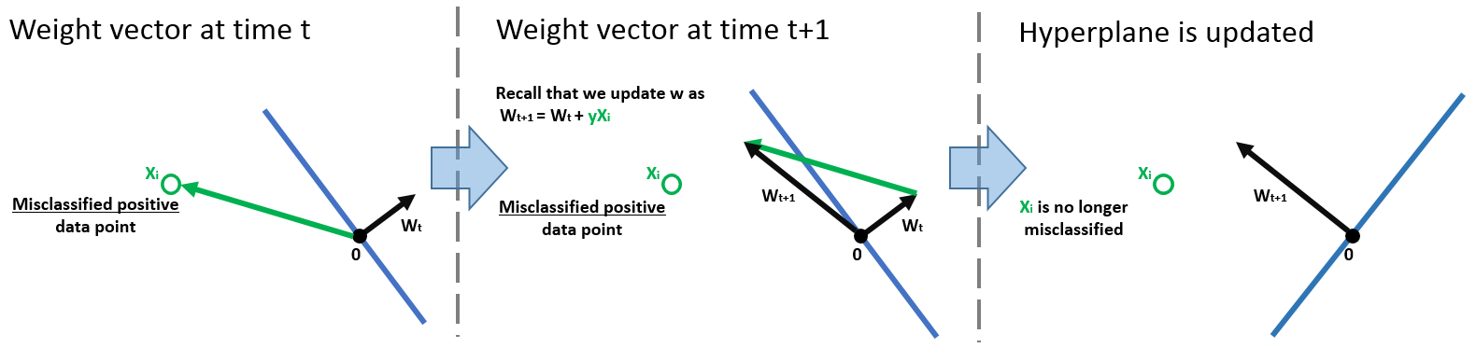
Visualization
Red: decision surface before update
  y is on the wrong side
Greed: decision surface after update
  y is on the proper side

Slide 18
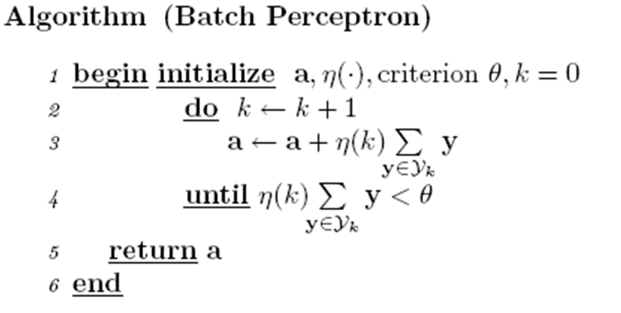
Training in batch
The perceptron update rule modifies the weights after each sample
  This is what we call on-line learning
The off-line of batch variant updates the weights using all misclassified samples:
Y_{k} is the set of all
misclassified examples
η(k) is the learning rate
(a small positive value, which
is constant, or decreases)

Slide 19
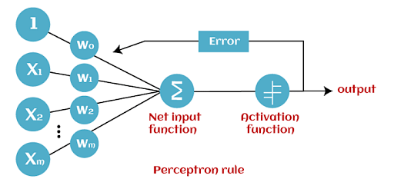
Training by optimizing a target function
This group of methods requires us to quantify the error of the classifier by some function
  This function is called the error function, cost function, objective function, target function,…
The parameters of this function will be the weights
We will find a proper set of parameters by optimizing the target function

Slide 20
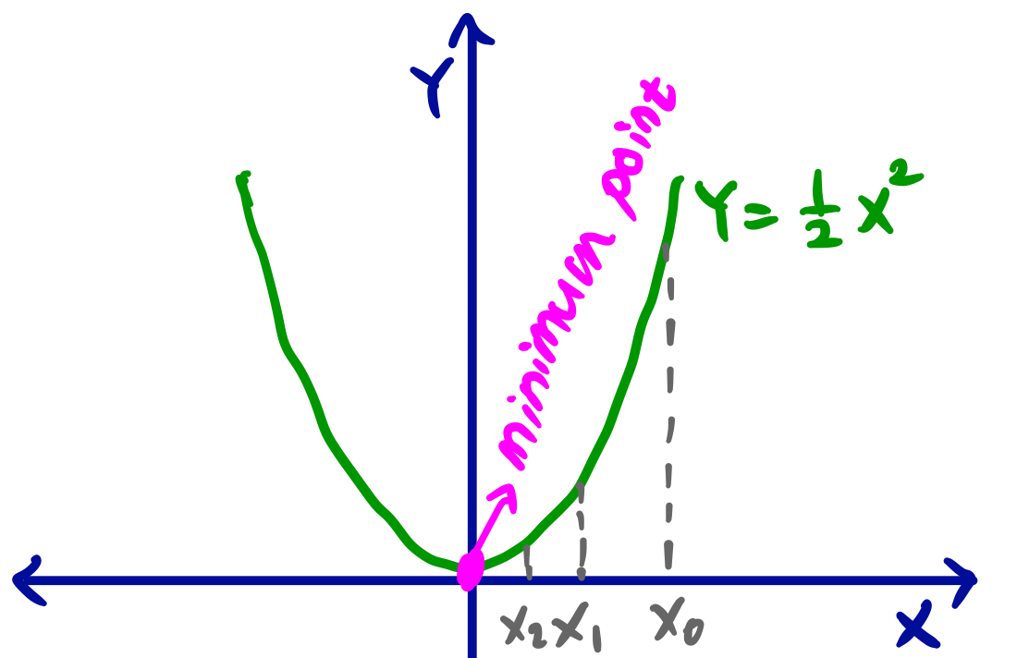
Minimizing the error function
This turns the machine learning problem into an optimization problem
In the simplest case we can find the global optimum by a closed formula
In more complex cases we will use iterative algorithms
  In the most complex cases these iterative algorithms will guarantee only to find a local optimum, not a global optimum

Slide 21
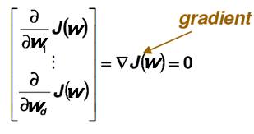
Gradient descent
The simplest general optimization algorithm for multivariate functions
Suppose that we want to minimize a function of many variables:
J(w) = J(w₁, …, w_{d})
We know that in the minimum point the derivative is zero
  So, theoretically, we should calculate the partial derivatives and set them to zero:

Slide 22
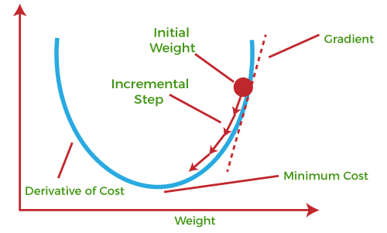
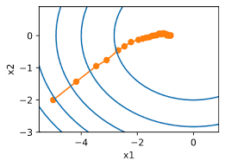
Gradient descent #2
However, in many practical cases we cannot find the zero point of this function analytically
The gradient descent algorithm iteratively decreases the target function instead
  By stepping in the direction of the steepest decrease…
  …which direction is given by the gradient vector

Slide 23
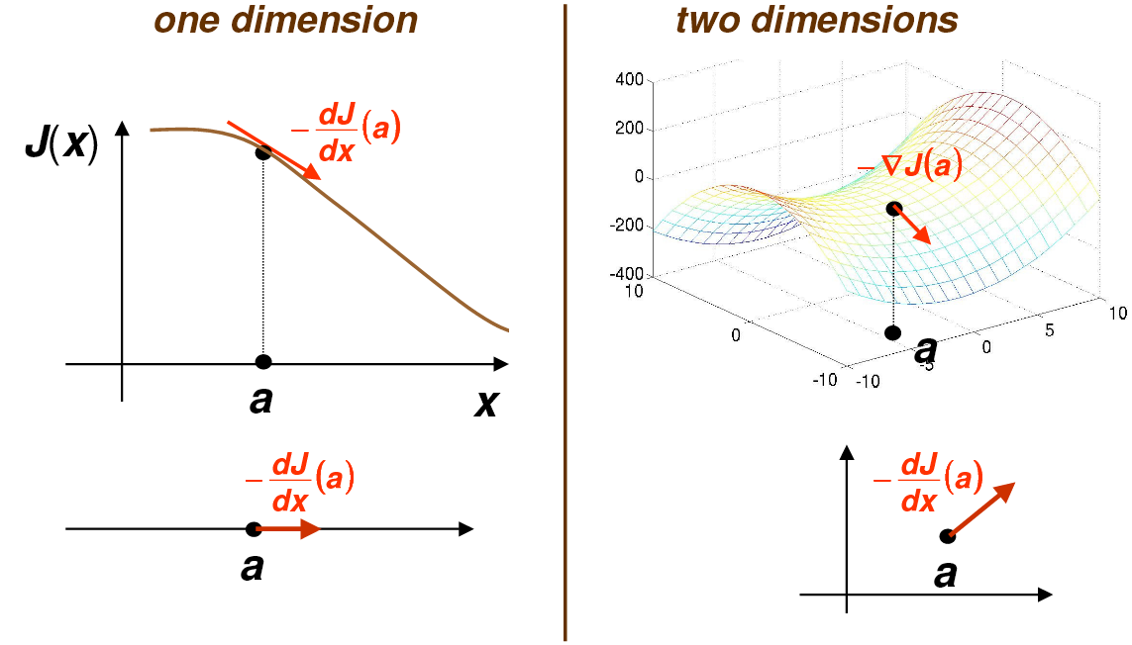
Gradient descent visualization

Slide 24
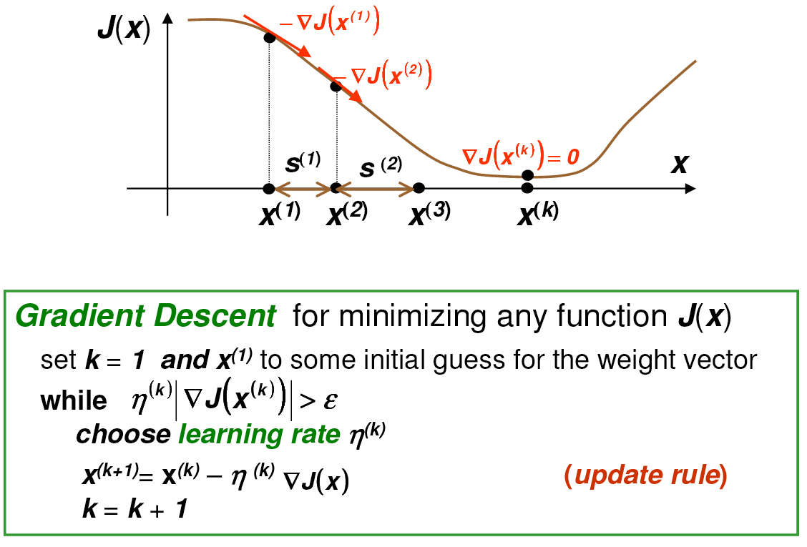
Gradient descent – the iterative method

Slide 25
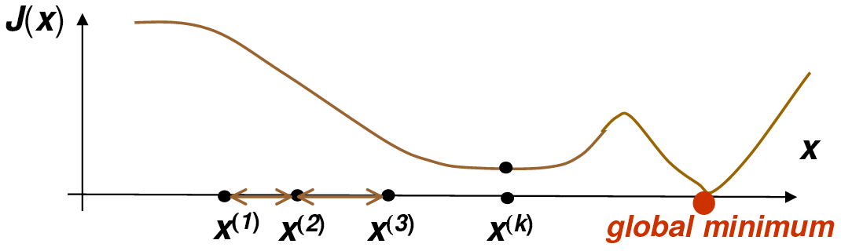
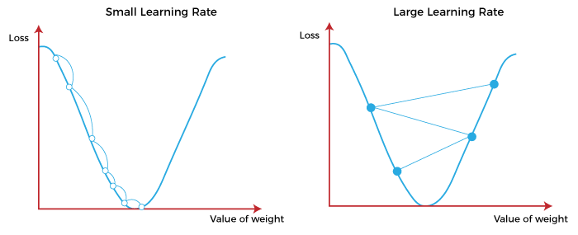
The weaknesses of gradient descent
The gradient descent may stuck in a local optimum
If the learning rate is too small,
the algorithm converges too slowly
If the learning rate is too large,
we won’t find the optimum
  Due to this, we usually start with a large
  learning rate and gradually decrease it

Slide 26
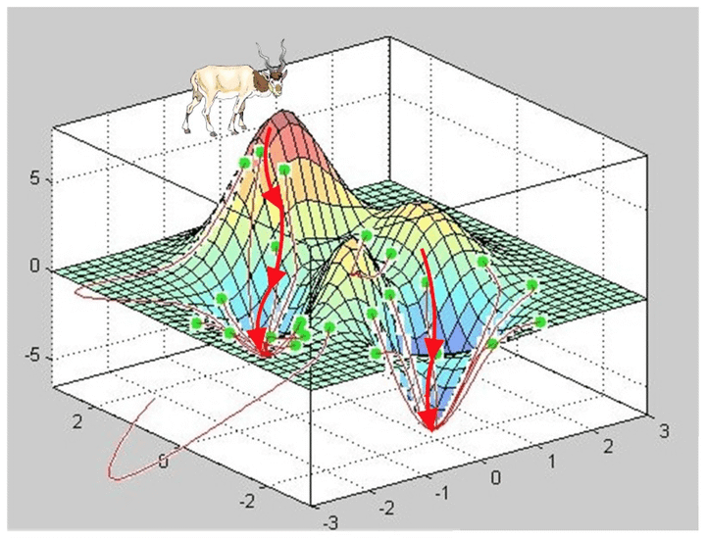
Variants of gradient descent
We usually define the error of the actual model (parameter set) as the sum of the value of the error function for all training samples
  In this case, the gradient descent algorithm is very similar to the off-line or batch version of the perceptron algorithm
However, we can also apply the on-line or semi-batch version of the algorithm – we process the training data in batches
  This is the Stochastic Gradient Descent (SGD)

Slide 27
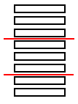
Stochastic Gradient Descent
We split the data to batches
  In this case we calculate the error only over one sample or
  a subset (batch) of the samples before updating the weights
We calculate the error over a different subset of the samples in each iteration, although the error function covers all training examples
  In each iteration, we optimize a slightly different version of the original target function
  This introduces a slight randomness into the process
  In practice it is not harmful, but in fact helps avoid local optima, and also makes convergence faster

Slide 28
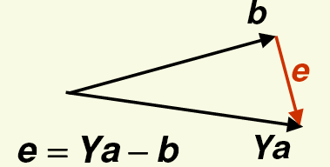
The Mean Squared Error (MSE) error function
We want to find the weight vector a so that a^{t}y_{i} > 0 ∀y_{i}
Let’s define a b_{i} target value for all samples: a^{t}y_{i} = b_{i}
And let’s define the training error as:
This will be the “mean squared error” error function
  And the problem is turned into a regression task
This is a linear task → „least squares linear regression”
What values are good for the b_{i} target values?
  They should be positive
  In lack of any further information, we can use b₁ = b₂ = … = b_{n} = 1

Slide 29
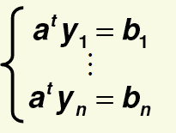
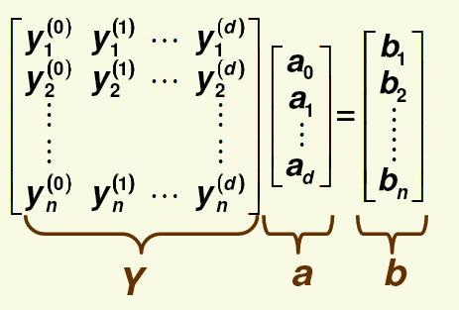

Least squares linear regression
We need to solve n linear equations:
In matrix notation:
So, shortly, with matrix notation:

Slide 30
Least squares linear regression #2
We need to solve a linear system: Ya = b , where the size of the matrix Y is n ∙ (d+1)
If n=d+1, then Y is a square matrix, and if Y is nonsingular, then there is exactly one solution: a = Y⁻¹b
  …but this rarely happens in practice
Usually the no. of examples is much higher than the no. of features
  In this case the equation system is overdetermined (we have more equations that unknowns), so there is no exact solution
  So the MSE error cannot be 0
  But we can still find a solution that minimizes the MSE error function

Slide 31
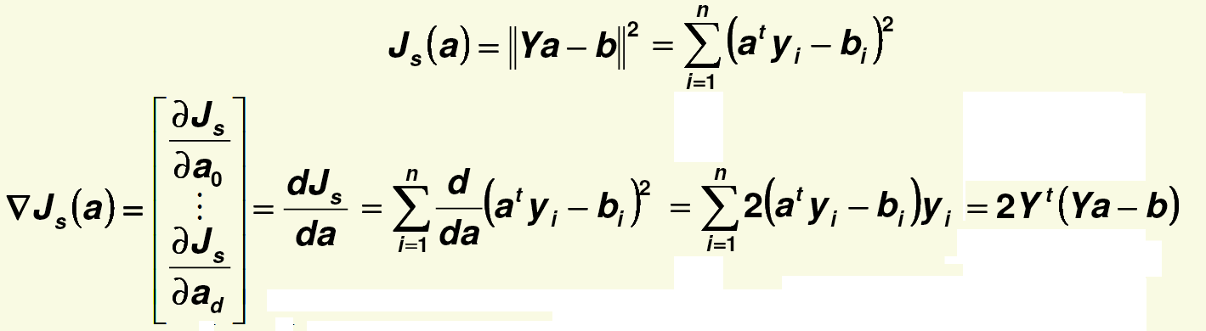



Minimizing the MSE error
We minimize the MSE error by calculating its gradient:
  …then we set the gradient to zero:
  If the inverse of Y^{t}Y exists, the unique solution is:
  (Y^{t}Y)⁻¹Y^{t} is called the Moore-Penrose pseudo-inverse of Y, because

Slide 32
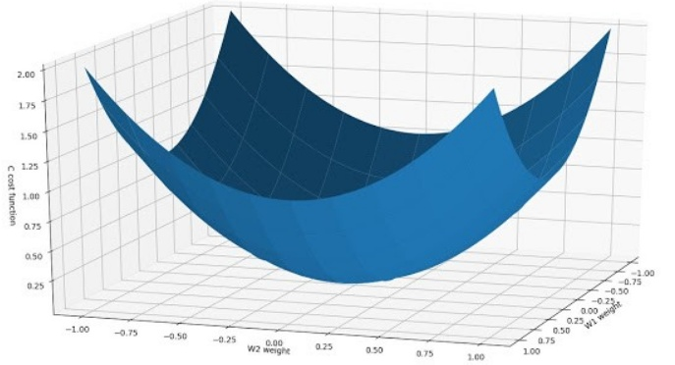
The drawbacks of the analytical solution
Might the solution with a closed formula have drawbacks?
  In n or/and d is very large, working with the Y matrix may be too costly (matrix multiplication/inversion)
  If Y is close to singular (e.g. some samples are highly correlated), the matrix inversion may become numerically instable
Due to these, let’s use an iterative solution instead!

Slide 33
Minimizing the MSE error using gradient descent
We can also use the gradient descent optimization procedure to find the minimum of the MSE error function
In this case, it is also guaranteed to find the global optimum
  because the error surface is
  a quadratic bowl, it has no local optima (only a global optimum)
  Wwe have to take care to gradually decrease the learning rate, though
  Otherwise we only approach the optimum

Slide 34
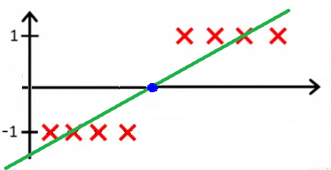
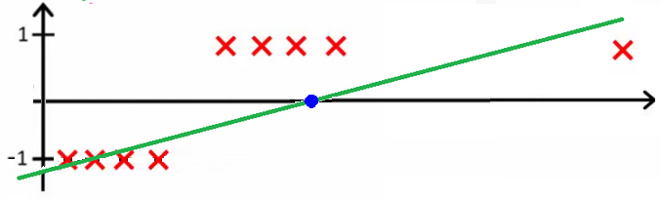
Problems with the „least squares linear regression” approach
We set the target value to 1 for all positive examples, and to -1 for all negative examples
  remember the normalization step!
This is what we are trying to do
in 1D:
This is what happens when a
sample is on the right side, but
it is too far away:

Slide 35
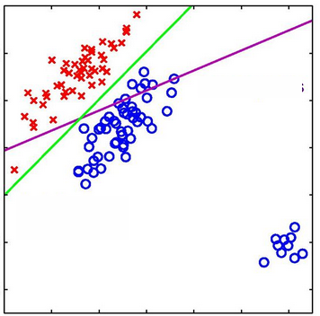
Problems with linear regression
EAnother example in 2D (showing only the decision surface):
The algorithm pays too much attention to samples far away from the decision surface
Some possible solutions:
  Modify the target values → Ho-Kayshap method
  Modify (generalize) the discriminant function → logistic regression
  Modify the error function → Support vector machines

Slide 36
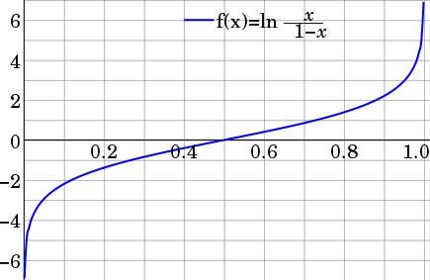
Logistic regression
Obviously, it makes no sense to force a linear function to take the value of ±1 in many points.
So we modify the shape of the regression function
  This is how we arrive to logistic regression
  It is a special case of generalized linear modeling
  Our new curve will be able to take (approximately) the values of 0 and 1 in many points, this is why it is called a “logistic” (“logit”) function
  Its values can be interpreted as probabilities → Bayes decision theory!

Slide 37
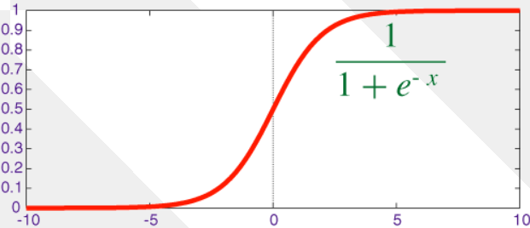
Logistic regression #2
Instead of using the linear discriminant function directly
g(x) = w^{t}x + w₀
…we embed it to the σ sigmoid function:
…so our discriminant function will be the following:
g(x) = σ(w^{t}x + w₀)

Slide 38
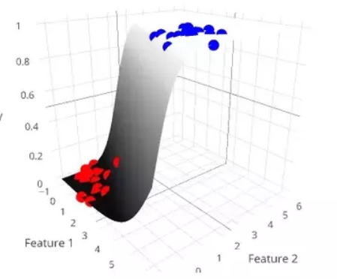
Advantages of logistic regression
The shape of the new discriminant function is more suitable to fit two target values (0 and 1 for two classes)
The output of g(x) is now between 0 and 1, so it can also be interpreted as an estimate for P(c₁|X)
  P(c₁|X) = g(x)
  P(c₂|X) = 1-g(x) (since P(c₁|X) + P(c₂|X) = 1)
So choosing the class for which g(x) is larger will now coincide with Bayes’ decision theory!

Slide 39
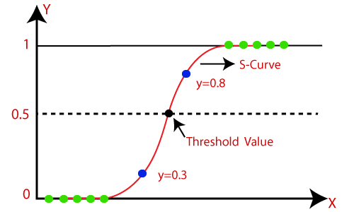
Maximum likelihood logistic regression
How can we optimize the parameters of g(x)?
To formalize the likelihood of the samples, we introduce the target value t=1 for samples of c₁ and t=0 for samples of c₂
Notice that we want to maximize g(x) for c₁ ,
and 1-g(x) for c₂
So we can formalize the likelihood of the training samples as
  For each sample, only one of the two terms is different from 1!

Slide 40
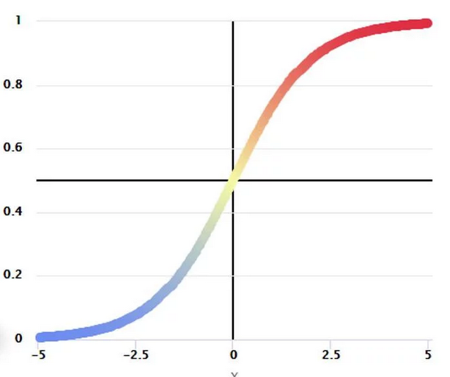
Maximum likelihood logistic regression #2
ML value:
Instead of the likelihood, we will maximize the log-likelihood:
Taking it with a negative sign, it is also
called the cross-entropy error function
  The cross-entropy of g(x_{i}) and t_{i}
  So maximizing the likelihood = minimizing
  the cross-entropy

Slide 41
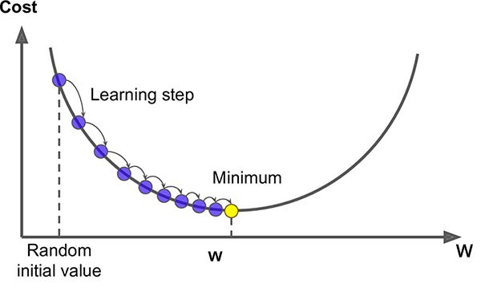
Maximum likelihood logistic regression #3
Log likelihood → max:
Ideas to solve?
Optimization by setting the derivative to zero
  Unfortunately, no simple closed-form solution exists
Maximization by applying gradient descent
  The error function is convex and has a unique optimum (which is good!)

Slide 42
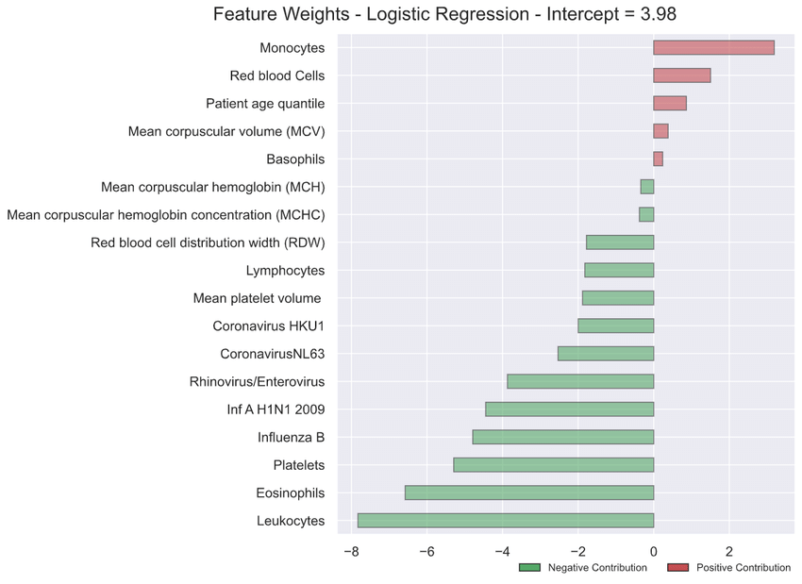
Interpretability of logistic regression
Our model takes the form: g(x) = σ(w^{t}x + w₀)
So all features are multiplied by a weight, then summed up (and transformed by the sigmoid)
  This is also true for all linear models BTW
From this we might extrapolate for the importance of each feature
  A weight of 0.0001 → not too important
  Of course, it is sensitive for feature scaling
  We can also discard features with smaller weights → feature selection

Slide 43
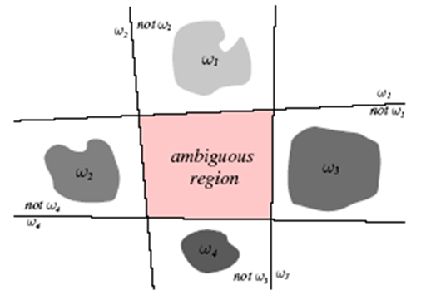
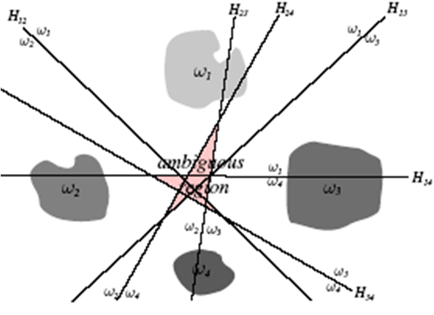
Multiple classes
One linear decision boundary can separate only two classes
So, to separate m classes we need more than one linear classifier
strategy #1: „one against the rest” strategy #2: „one against another”
(m decision boundaries) (m(m-1)/2 decision boundaries)
But both solutions may result in ambiguous regions

Slide 44
The linear machine
For m classes, let’s define m linear discriminant functions
g_{i}(x) = w_{i}^{t}x + w_{i0} i=1, 2, …m
And classify a random sample x according to the maximum:
g_{i}(x) ≥ g_{j}(x) ∀j ≠ i
Such a classifier is called the linear machine
A linear machine divides the feature space into m decision regions, where g_{i}(x) is the largest discriminant in region R_{i}
The maximum decision rule solves the problem of the ambiguous regions
  The maximum is defined in all points of the feature space

Slide 45

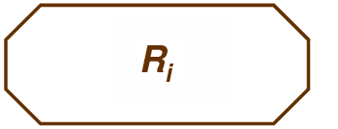

Decision regions for the linear machine
The decision regions defined by the linear machine are convex and contiguous
So this is a possible region: But not this:
So we won’t be able to solve
problems like this:
Obviously, the capabilities of linear
machines is rather limited
This is why we will improve over it
  This will lead to Support Vector Machines
  …and to artificial neural networks

Slide 46



Decision regions for the linear machine
Two examples for the decision regions of a linear machine:
Decision boundary between two adjacent classes:
The normal vector of H_{ij} is (w_{i}-w_{j}), while the signed distance of x and H_{ij} is:

Slide 47
Training the linear machine
The linear machine has m linear discriminant functions:
g_{i}(x) = w_{i}^{t}x + w_{i0} i=1, 2, …m
We can optimize the weights of each of these functions to separate the actual class from all the other classes (“one against the rest” approach)
  This way, we reduce the m-class classification task to m 2-class tasks
Each of these linear classifiers can be trained separately
  Actual class: c₁ ; all the other samples: c₂
Any of the previously discussed methods can be used for training

Slide 48
Multiclass logistic regression
Similarly to logistic regression for two classes, we can modify the linear regression function to a function that returns non-negative values between 0 and 1, and the outputs add up to one
  These outputs can be interpreted as posterior probabilities P(c_{k}|X)
We will use the softmax function for this (k is the class index):
Let’s define the target vector as: t_{i} = (0, 0, …, 1, 0, 0), where there is only one 1 at the kth position, where k is the class of the ith sample
  This is also known as “1-of-K” coding (or “one-hot encoding”)

Slide 49
Multiclass logistic regression #2
Using the 1-of-K target vector, the likelihood will be:
  For each x_{i} vector only one of the K terms is different from 1!
Taking the negative of the logarithm, we obtain the cross-entropy error function for multiple classes
  Notice that again, only one component is different from 0, which is the component that belongs to the correct class
Similarly to the two-class case, we can perform the optimization by calculating the derivative and applying gradient descent

